Slide 1
Spring Data REST: Getting Started
COURSE OVERVIEW

Slide 2
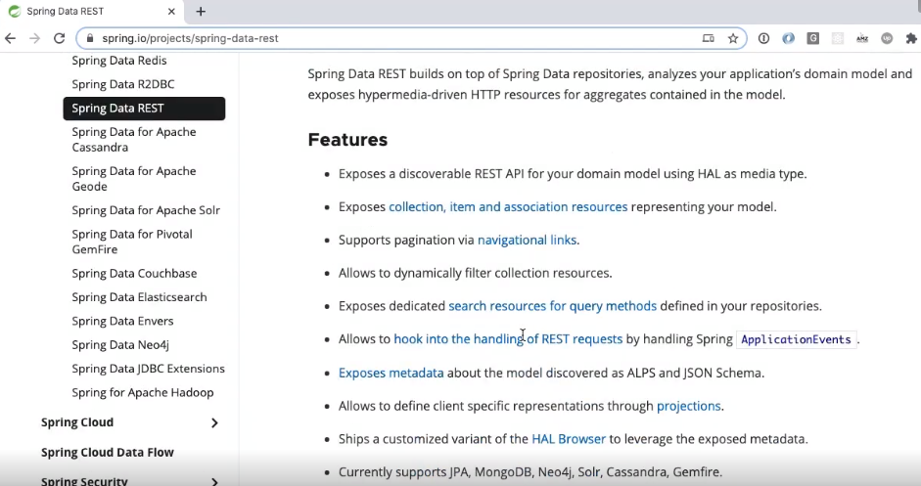

Slide 3
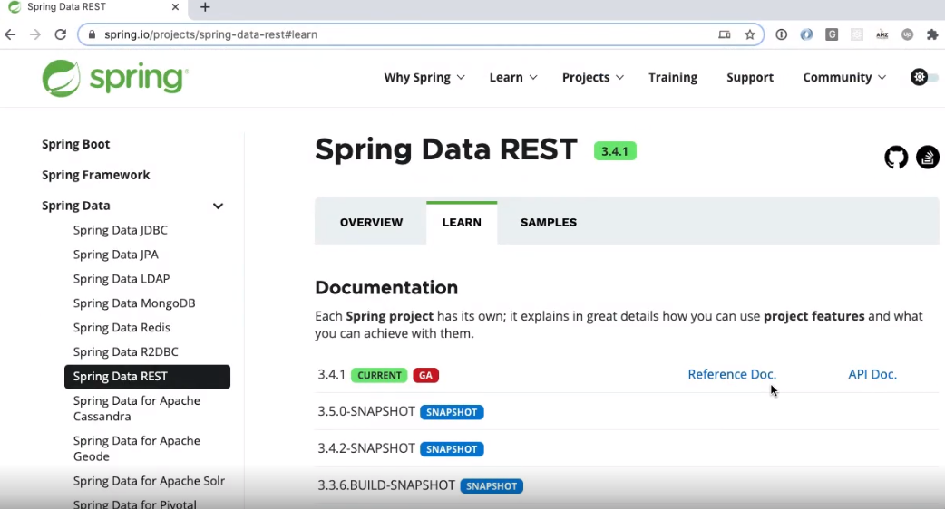

Slide 4
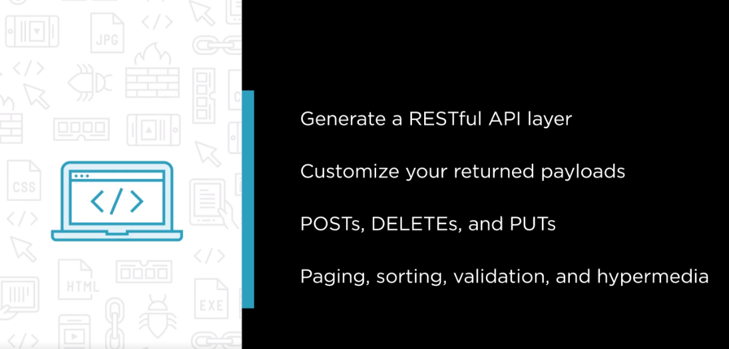

Slide 5
